Slide 1

Kalinin Danil
Volkov Andrey
Komarov Ivan
Patrusheva Elena
Gimaeva Susanna
Innopolis University B17-05 & B17-06
4th April 2019

Slide 2
Agenda
1
What Elasticsearch is?
2
When to use?
3
Demo
4
Pros, cons and alternatives

Slide 3

What is Elasticsearch?
Search and analytics engine
Open source (Apache License)
Distributed
Scalable
Written in Java

Slide 4
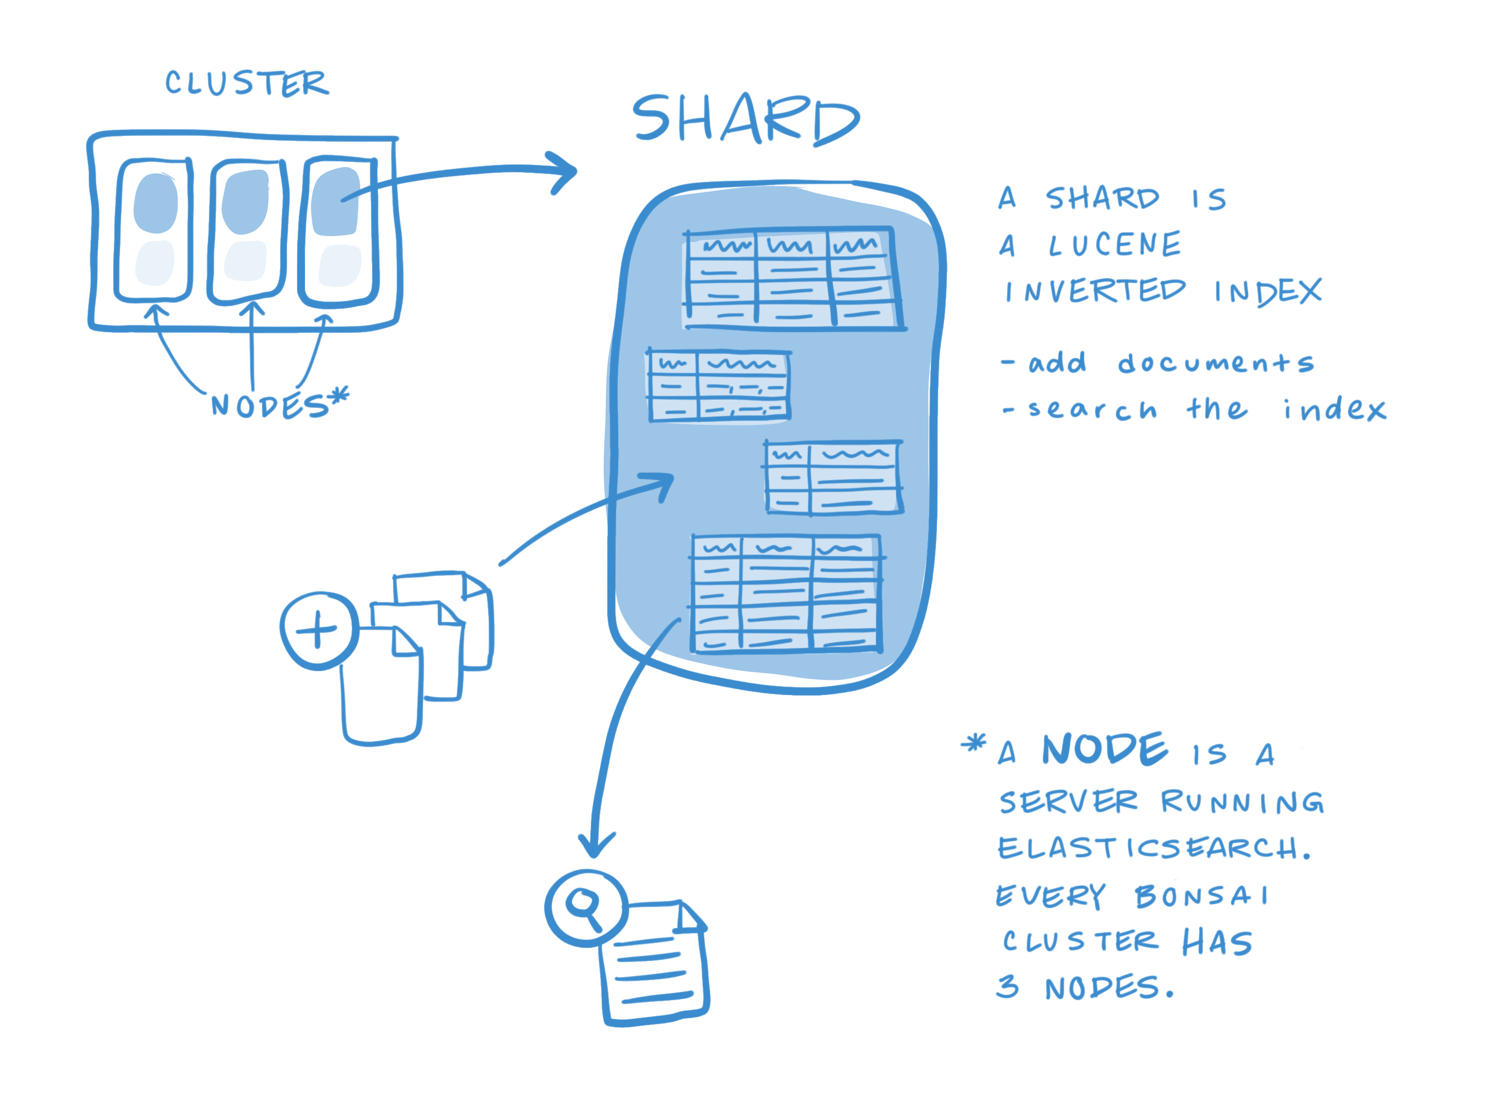
Main concepts
4 Organs of Elasticsearch
Clusters
Nodes
Indexes
Shards (and Replicas)
Documents

Slide 5
Use cases
Online web store
Search for products
Customer carts
Price alerting platform
Match price movements against customer queries
Effective time series retrieving
Transaction data collection
Analyzing for trends
Data mining
Data analysis
Demand of fast search
Complex filters

Slide 6







Who uses Elasticsearch?

Slide 7


Advantages
Speed
Obviously it is the main reason why to use elastic search. The performance that you gain in searching is incomparable with relational databases.
Documentation
The official documentation provides you with excess information about the product. Moreover it explain everything in a logical order from main concepts to real implementation.
Popularity
The community of Elasticsearch is increasing with each year. There are a lot of tutorials on integrating its into your stack and applications. For example using it for smart search with Django.

Slide 8

Advantages
Rapid features development
Elasticsearch is developing very fast. It has quickly caught up to the competition and most of the currently missing features are due to be released in upcoming versions.
Open source
It is free and open source. So everyone can use it on free basis without paying any money.
RESTful JSON API
Search can be executed either using a simple, Lucene-based query string or using an extensive JSON-based search query DSL. By structuring the query as a JSON object you can be very explicit and can dictate exactly what Elasticseach will return.

Slide 9


Disadvantages
Near Realtime (NRT)
There is a slight latency from the time we index a document until the time it becomes searchable.
Disk space
Using Elasticsearch you will have to store about x2 original data. It is not a problem when amount of your data is small but if it goes to petabytes it may cost lots of money.

Slide 10






Alternatives

Slide 11






Additional resources
Basics of the Elasticsearch
What are nodes, shards, indexes
Installation guide
Video introduction to Elasticsearch
Integration with your own project
Django
Node.js
Spring

Slide 12
Demo

Slide 13
Questions

